Slide 1
How to Use this Presentation:
Double-check each slide carefully to be sure that all points are applicable to your plans.
Copy and paste the slides into your open enrollment presentation.
To increase your enrollment rate, we recommend that you present these slides after you discuss your medical, vision and dental plans.
If a slide has a video on it, simply click the video to open it in your browser.

Slide 2
Health Savings Account

Slide 3
What is an HSA?

Slide 4
Health Savings Account
A health savings account (HSA) is like a personal savings account for medical expenses for you, your spouse or tax dependent.

Slide 5
Health Savings Account
Key Features
Triple tax savings: contributions, investment growth, and qualified withdrawals are tax free
Your HSA is yours to keep forever, even if you switch health plan, jobs, or retire
You can pass HSA money to your heirs
Your money rolls over year to year and can be invested for long-term growth
Any money you put into your HSA reduces your federal income
Once you have a minimum of $500 in your HSA, you can choose to invest your funds using mutual fund investment options

Slide 6
Health Savings Account
HSA Eligibility:
Must be enrolled in an HSA-qualified High-Deductible Health Plan (HDHP)
Cannot be covered by any other insurance that reimburses for health expenses (including a medical FSA)
Cannot be enrolled in any part of Medicare or Medicaid
Cannot be claimed as a dependent on another person’s tax return
How much you can contribute:
$4,150 for self
$8,300 for family
55+ year olds can contribute an additional $1,000

Slide 7
Health Savings Account
Customer Information Program (CIP)
The Customer Information Program (CIP), required for all participants who enroll in an HSA, is a combination of requirements set forth in Section 326 of the USA Patriot Act, which states that all financial institutions must verify the identity of individuals wishing to conduct financial transactions with them. During the CIP process, any outdated or missing information will prompt the bank to reach out, and any irregularities could cause a CIP failure on the account. If a failure occurs, Ameriflex will send an email to request additional information for verification purposes. To verify the provided information, you will likely have to provide one of the following: a copy of your driver's license, a copy of a birth certificate, and/or a copy of a utility bill, etc.

Slide 8
Eligible Expenses

Slide 9
Deductibles . Copays . Prescriptions

Slide 10
Teeth Cleaning

Slide 11
LASIK . Glasses . Contact Lenses

Slide 12
Over-the-Counter Medications. Menstrual Care products . And much more
Notes:
To review a few list of eligible expenses, log in to MyAmeriflex and visit the “Resources” tab under the Help Page. https://tax.thomsonreuters.com/site/hcet-ebia/ameriflex
To purchase FSA-eligible items online, visit the FSA Store.

Slide 13
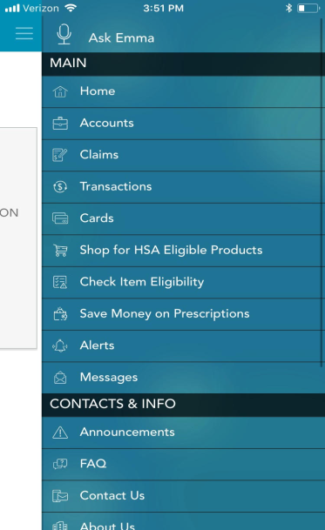
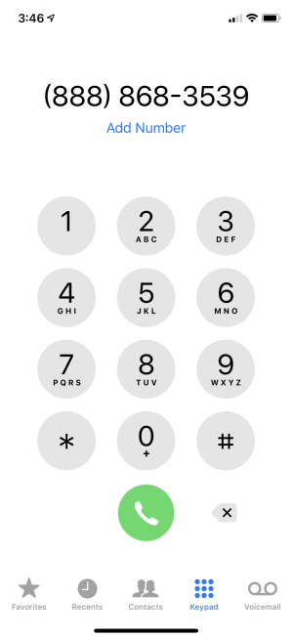
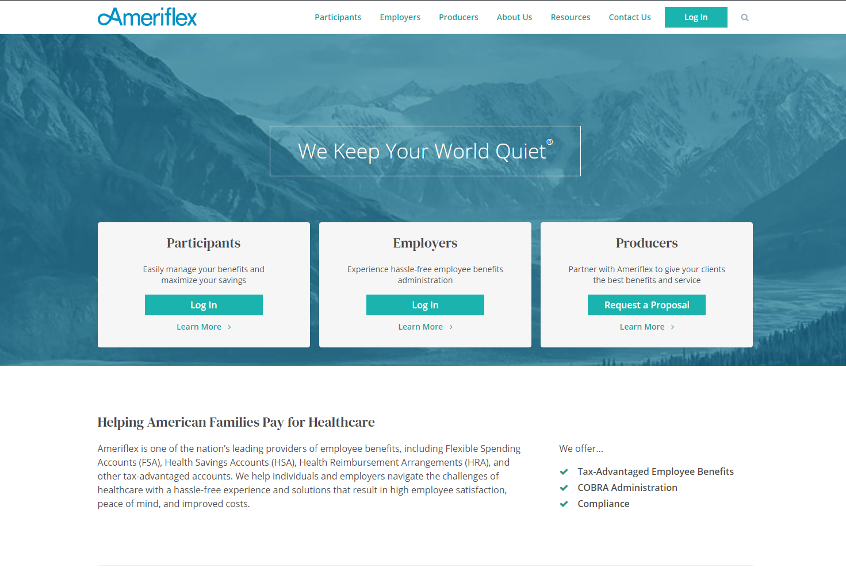
Ameriflex Support
Download the Mobile App
Call Us at
888.868.3539
Visit
www.myameriflex.com

Slide 14
Questions?

